Slide 1
Integer Overflow

Slide 2
-Absolute value describes the distance from zero that a number is on the number line
Absolute Value and ABS Function
-So the ABS function or the absolute value function always returns a non-negative value

Slide 3
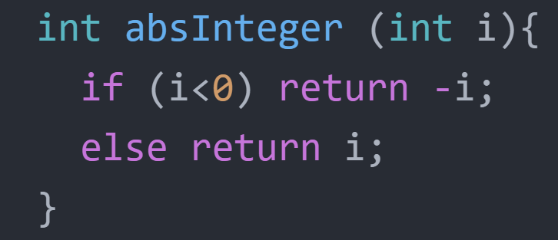
So which is the int that this ABS function runs wrong?

Slide 4
Range of Int:
-2,147,483,648 to 2,147,483,647
-2,147,483,648
2,147,483,647
-2,147,483,648 to 2,147,483,647
|-2,147,483,648| > |2,147,483,647|
The absolute value of Min has exceeded the Max of type Int

Slide 5
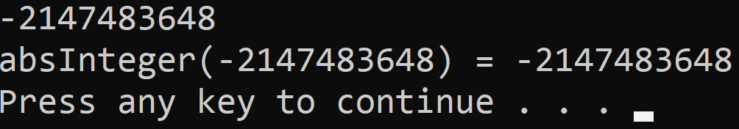
So what if we enter the smallest number into the ABS function above?
The function returned a negative value?

Slide 6
What is the reason?

Slide 7
Range: 1-4
I will rotate to the largest number
1
At this time, if we rotate more, the
result will return the first value
Overflow
4
2
3

Slide 8
The same is true for the ABS function

Slide 9
--2,147,483,648
-2,147,483,648
-2,147,483,648
2,147,483,648
But Output now exceeds the range of Int, so the return result will be the smallest number of type
Because the input is a negative number, we will add a - in front, this time the number will become a positive number

Slide 10
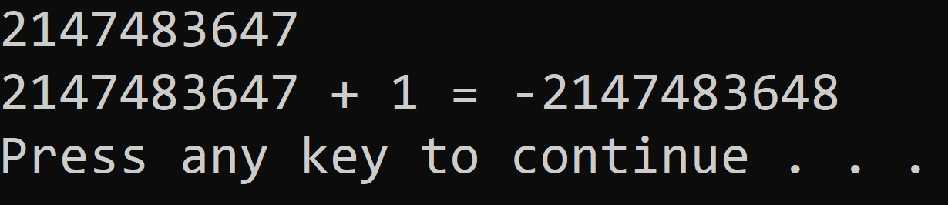
Same when we add Max of type

Slide 11

Integer Overflow
Animation HieeuSPhamJ
Script Kalaeaz
Music Gone For Now
Inspired by 3Blue1Brow
CyberJutsuTV
Thanks for watching

